Slide 1
Nuclear Fuel Performance
NE-533
Spring 2022

Slide 2
Last Time
Wrapped up thermomechanics
Overviewed US fuel performance codes

Slide 3
Material Property Evolution

Slide 4
Pretty much everything we have learned so far, nothing changes once the fuel and cladding reach steady state

Slide 5
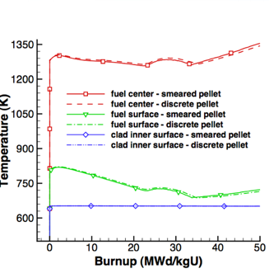
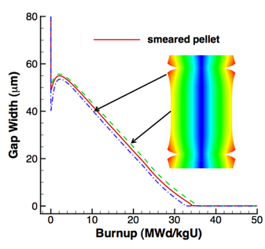
Fuel is dynamic!

Slide 6
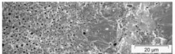
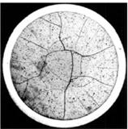
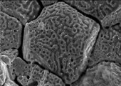
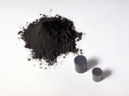

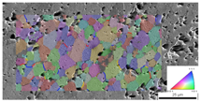
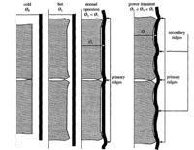
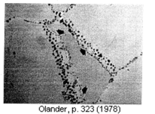
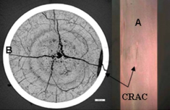
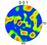
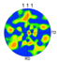
Property changes due to microstructure evolution during reactor operation must be considered
Insertion in reactor
Removal from reactor
Early life
Thermal expansion
Fracture
Point defect and fission gas generation
Fuel Densification
Mid Life
Point defect diffusion
Point defect clustering
Fission gas segregation to GB and voids
Bubble nucleation
Late life
Fission product swelling
Bubble percolation and fission gas release
Cladding creep
Fuel creep
Fuel failure
Pellet/cladding interaction
Cladding corrosion
Cladding fracture
Fuel Fabrication
Sintered UO²
Height 2 cm
Diameter 1 cm
~10 μm grain size
Density > 95%
Brohan 2000
From Pedro Peralta, ASU
Zinkle and Singh 2000
Santana et al. 2011

Slide 7
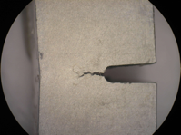
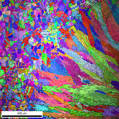
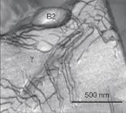
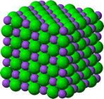
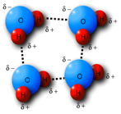
The properties and performance of a material are a result of factors across various length scales
Material properties and performance
Microstructure
Defect interactions
Crystal structure
Chemical bonds

Slide 8
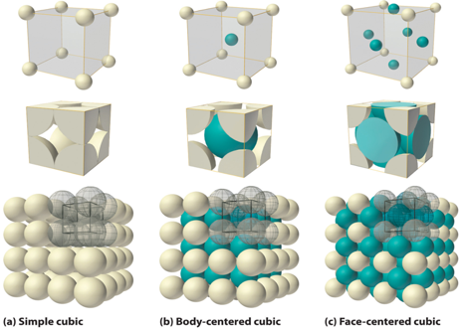
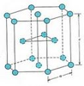
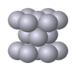
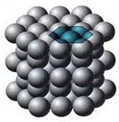
The crystal structure of a material is the shape of the ordered structure of the atoms
The atoms of many materials form an organized lattice, these are called crystalline materials. All reactor materials are crystalline.
The configuration of the atoms in the lattice impacts the properties of the material (density, thermal expansion coefficient, elastic modulus, etc.)
All major light water nuclear materials are either cubic or hexagonal
(d) Hexagonal close packed

Slide 9
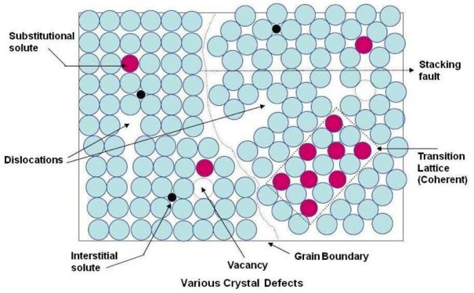
Crystalline materials
In crystalline materials, the lattices are not perfect, they have defects
Defects can be 0D, 1D, 2D, 3D
The interactions between defects seriously impact material properties and how they perform

Slide 10
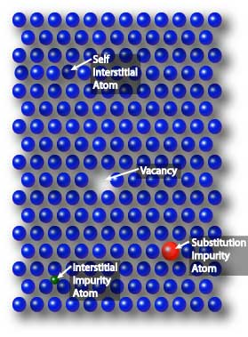
Point defects
Point defects (zero-dimensional defects) are lattice imperfections related to one or two lattice sites
There are several types of point defects
Vacancies
Self interstitial atoms (SIA)
Interstitial impurity atoms
Substitutional impurity atoms
Point defects control the mobility of atoms and, therefore influence all processes that depend on diffusion

Slide 11
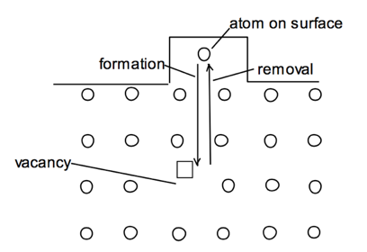
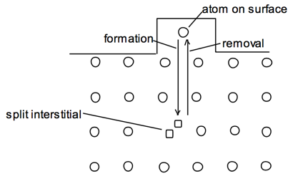
Point defects
Vacancies and interstitials form naturally in materials
Extra atoms can sit on a surface, creating a vacancy, or a surface can have a missing atom, creating a self interstitial atom (SIA)
We define the number of vacancies or interstitials in terms of a concentration
There exists an equilibrium concentration of point defects

Slide 12
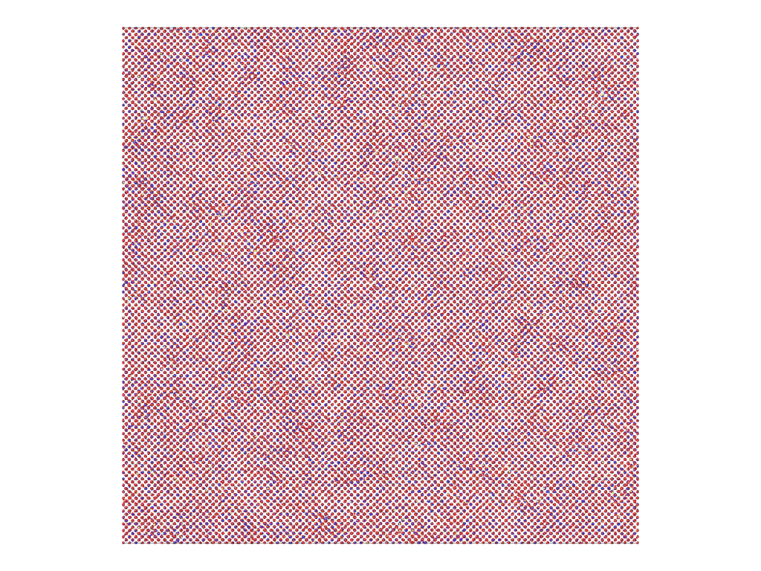
Radiation damage
Ionizing radiation can introduce defects into the crystal lattice, called radiation damage
PKA collisions create a collision cascade, which results in the generation of defects (point and clusters)

Slide 13
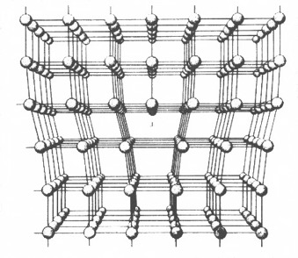
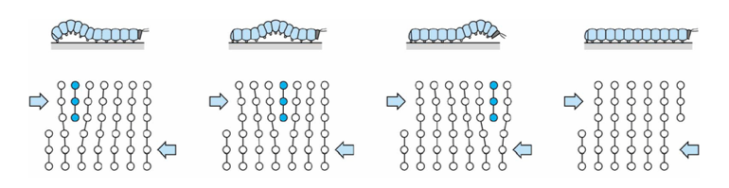
Dislocations are imperfections associated with a line of lattice sites (1D defect)
In a dislocation, an extra half plane of atoms is inserted into the lattice
When it moves, only a small number of bonds are broken at a time
Dislocation motion controls the plastic (permanent) deformation of crystalline materials

Slide 14
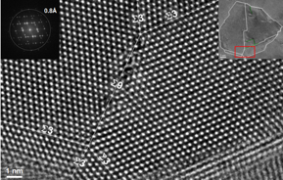
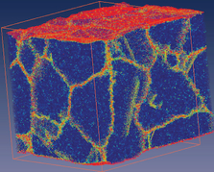
Grain boundaries
Materials are typically composed of various regions where the crystal lattice is oriented differently. These regions are called grains
When two grains meet, there is a plane of atoms that do not follow the crystal lattice called a grain boundary
Most crystalline materials are polycrystalline, not single crystal
High-res transmission eleectron microscopy can also show individual atoms (palladium)
www.knmf.kit.edu/TEM.php
Atomistic simulation of grain boundaries in 3D

Slide 15
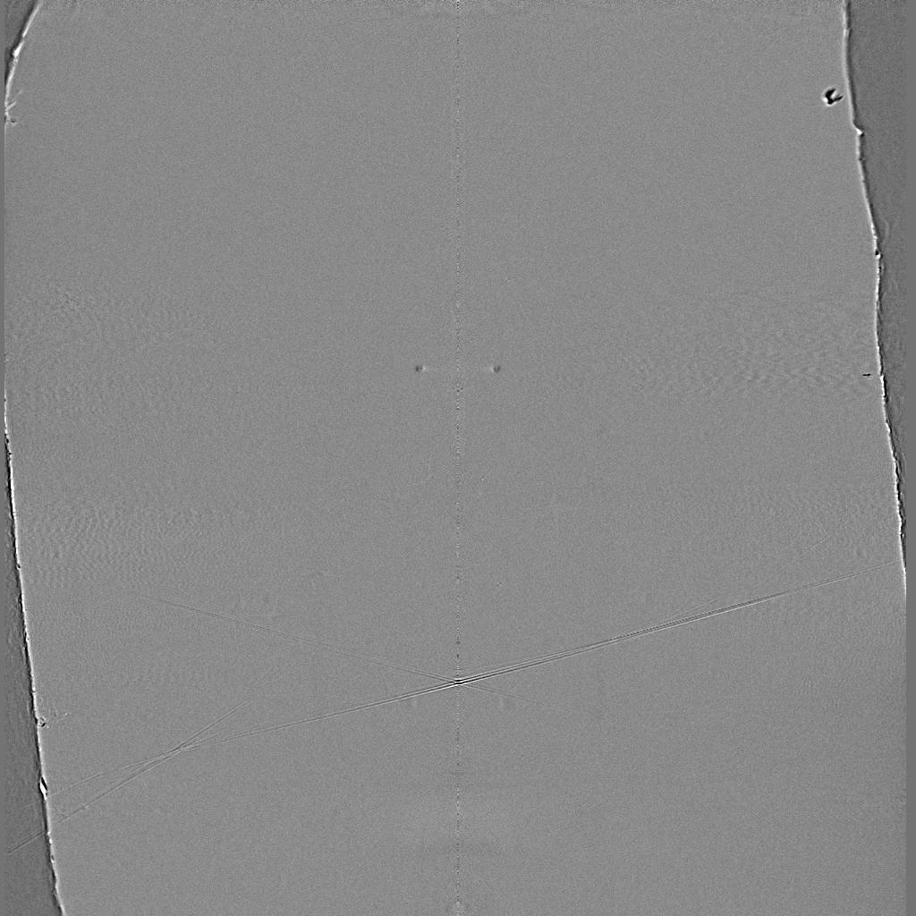
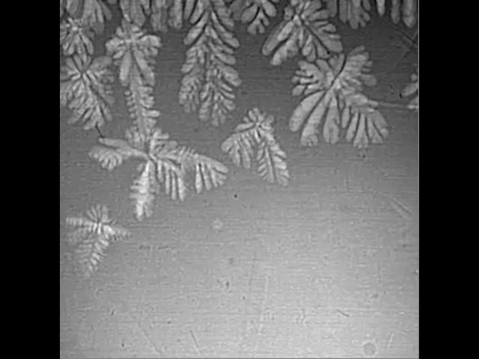
Metals are often cast, and polycrystals naturally form during casting

Slide 16
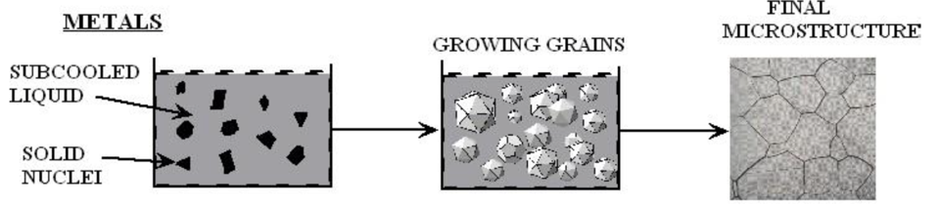
Polycrystals naturally form during casting
Solidification begins in different regions of the melt, each with a different orientation
Once the different regions meet, grain boundaries form between them

Slide 17
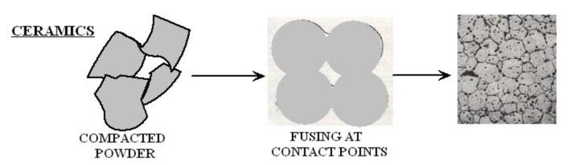
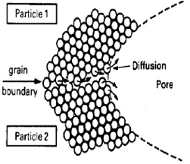
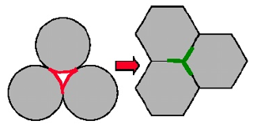
Ceramic sintering
Ceramics are typically sintered, and polycrystals also naturally form from sintering
In sintering, powders are compacted at high temperature
The particles are each oriented differently, and as the fuse, grain boundaries form
The differences between the grain orientations result in the grain boundary

Slide 18
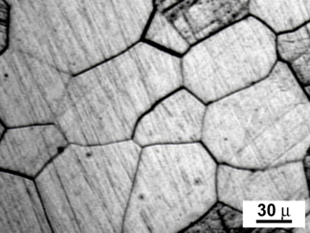
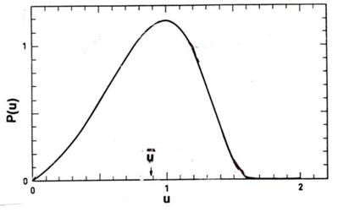
Distribution of grain sizes
In a polycrystal, there is also a distribution of grain sizes
Therefore, we commonly refer to the grain size distribution and the average grain size
The Hillert distribution is an analytical distribution for grain size
Real materials often vary from this behavior

Slide 19
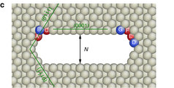
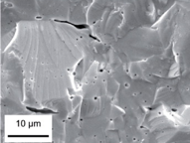
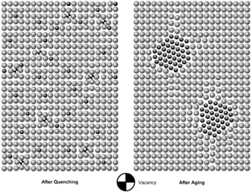
3D Defects
When point defects cluster, they form three dimensional defects
The energy of a point defects is reduced when several point defects cluster together
Larger clusters of vacancies are called voids
Clusters of impurity atoms are called precipitates

Slide 20
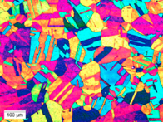
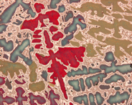
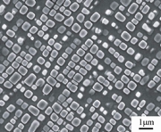
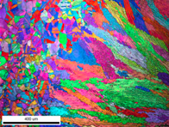
Microstructure
Material microstructure is the structure observable with 25x magnification
The microstructure includes grain structure, secondary phases, porosity, and more
The microstructure can strongly influence physical properties such as strength, toughness, ductility, hardness, corrosion resistance, high/low temperature behavior or wear resistance.
These properties in turn govern the application of these materials in industrial practice
Annealed Stainless Steel
Cast Bronze
Sintered UO2
Co-Al-W Superalloy
Friction stir welded stainless steel

Slide 21
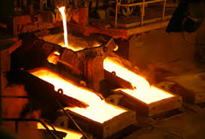
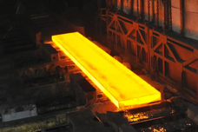
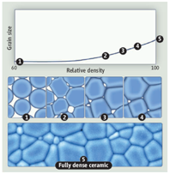
Material processing
The process we use to make a material has a huge impact on its microstructure and properties
Casting – manufacturing process in which a liquid material is poured into a mold and then allowed to solidify
Can be used to make complex shapes
The solidified microstructure typically has properties that are far from ideal
Sintering – Forming a solid from a powder using heat and/or pressure without melting the material
Applicable to metals and ceramics
Difficult to obtain a material that is fully dense
Used to make fuel pellets
Heat treatment – heating or cooling a material to extreme temperatures to get desired microstructure and properties
Used to control the rate of microstructure change, including diffusion, grain growth, or phase change
Use on many types of materials (metals, ceramics, glasses)

Slide 22
Summary
Even during steady state operation, fuel and pellet conditions change with time due to microstructure evolution
Atoms in the fuel and cladding materials are arranged in a crystal lattice
The crystal lattice is never perfect; it has defects
Point defects include vacancies, interstitials, and impurity atoms
Dislocations are line defects
Grain boundaries are planar defects
Voids and precipitates are volume defects
All materials have defects, radiation damage causes many more defects
Microstructure can be tailored through processing

Slide 23
UO2 Radiation effects

Slide 24
Thermal Conductivity Degradation
The physical effects caused by atomic displacements are rather complex and depend on the relative sink strengths of a given material for interstitials and vacancies and on the temperature
The defects that survive migrate through the crystal lattice where they cluster to form extended defects like dislocation loops, lines and networks, which can potentially be absorbed in grain boundaries, gas bubbles or precipitates, which act as sinks
Damage by fission also leads to changes in chemistry due to production of fission products
One of the major effects of defect formation is the degradation of thermal diffusivity, due to phonon scattering
Results obtained on irradiated UO2 show that the thermal conductivity is decreasing with increasing burn-up, and that at equal burn-up, samples with higher irradiation temperatures have higher thermal conductivity

Slide 25
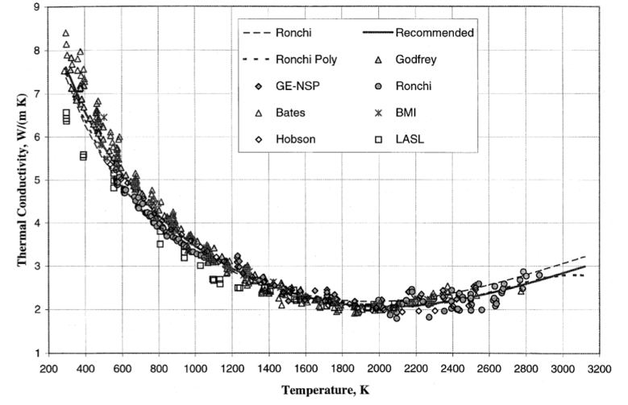
UO2 Thermal Conductivity
We have established correlations for thermal conductivity of fresh UO2 fuel as a function of temperature
Where t = T/1000
The first part of the equation describes the phonon interactions
The second part describes electronic transport which becomes significant at high temperature

Slide 26
UO2 Thermal Conductivity
UO₂ thermal conductivity is low and decreases more during reactor operation
The thermal conductivity has been collected after various amounts of burnup to make empirical fits

Slide 27
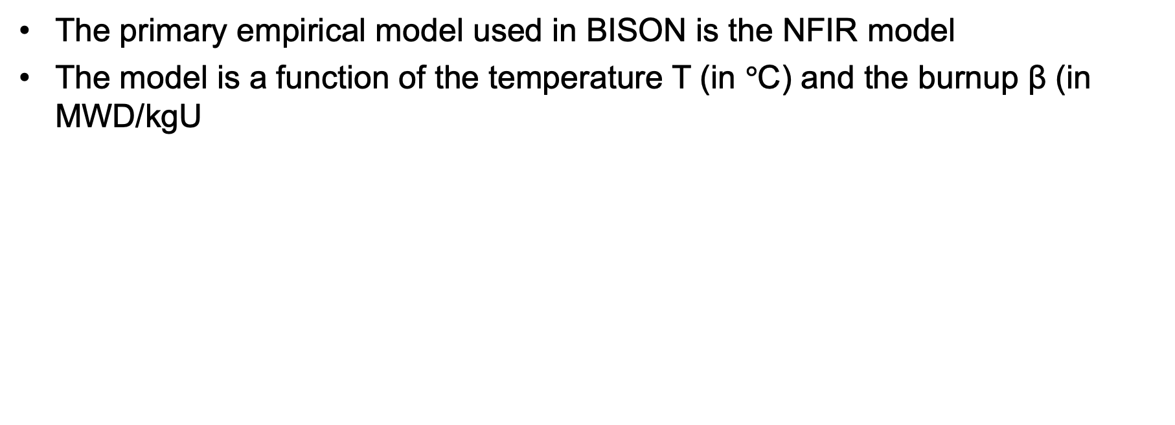
UO2 Thermal Conductivity
The primary empirical model used in BISON is the NFIR model
The model is a function of the temperature T (in $°$C) and the burnup β (in MWD/kgU

Slide 28
UO2 Thermal Conductivity
The R_{f} function switches between two k_{ph} functions

Slide 29



Physical Changes
An important effect of radiation damage is the volume increase of the crystal lattice, leading to macroscopic swelling of the fuel material
Alpha particle damage alone can cause approximately 0.4% swelling
Mechanical properties also vary with damage, increasing with dpa
UO2 does not become amorphous, but damage accumulation can eventually cause polygonization: transformed into a material consisting of very small grains

Slide 30
High Burnup Structure (HBS)
When thermal recovery is not sufficiently efficient (at lower temperatures), the accumulation of defects at high burnup can lead to the instability of the crystalline structure, initiating a restructuring driven by the energy stored in the material
Strong capture occurs in the periphery of the fuel pellet, leading to Pu production and an increase is fissile density
In UO2, grains subdivide from 10mm size to 100-200 nm size, and a densely porous structure is formed (~20% porosity)

Slide 31
High Burnup Structure (HBS)
The increase of the relative porosity volume degrades the material conductivity and reduces the mean grain size
On the other hand, the intragranular irradiation defect-cleaning improves the fuel intrinsic thermal conductivity
Fission gas in HBS bubble is retained, not released
Exact mechanism of HBS formation is not understood

Slide 32
Summary
Radiation damage leads to accumulation of defects in UO2, changing properties and microstructure
Thermal conductivity degrades with time
High Burnup Structure can form along the rim

Slide 33
Next Time
MOOSE overview
Good to bring a laptop, or to work remotely, so we can move towards getting an active MOOSE build you have access to

Slide 34
Fuel chemistry

Slide 35

Fuel Chemistry
UO₂ is an ionic compound that must have balanced charges
What is the charge of a typical oxygen ion?
O²⁻
Uranium valance states
Possible: U³⁺, U⁴⁺, U⁵⁺, U⁶⁺
Most stable: U⁴⁺, U⁵⁺, U⁶⁺
Beyond UO2, can have U4O9, U3O8, UO3
The structure is very stable all the way up to the melting temperature and down to extremely low temperatures, even with irradiation damage
There is space in the uranium lattice that can accommodate fission products

Slide 36

O/M ratio
The ratio of oxygen to uranium metal (O/M ratio) can vary
This is the stoichiometry
The homogeneity range of uranium dioxide extends to both hypo- and hyperstoichiometric compositions in oxygen
The minimum and maximum oxygen contents in the dioxide correspond to the compounds with the formula of respectively UO_{1.67} at 2720 K and UO_{2.25} at approximately 2030 K
Will the O/M ratio go up or down during reactor operation?
It is complicated, because of the formation of fission products that also react with the oxygen, and O interaction with Zr cladding

Slide 37

Excess O
The crystal structure of UO₂ can accommodate extra oxygen
Excess oxygen resides at interstitial locations
Oxygen in neighboring sites is displaced
Cation valence increases to maintain electrical neutrality
Fuel fabricated to be nearly stoichiometric; i.e., UO2.00± because:
It is the most stable
It has the highest melting temperature
[after Olander, 1976]

